Slide 1

Due to the requirements of UK copyright law and the
Copyright, Designs and Patents Act 1988, this presentation can only be
used for educational purposes.
Notes:
Copyright Disclaimer

Slide 2
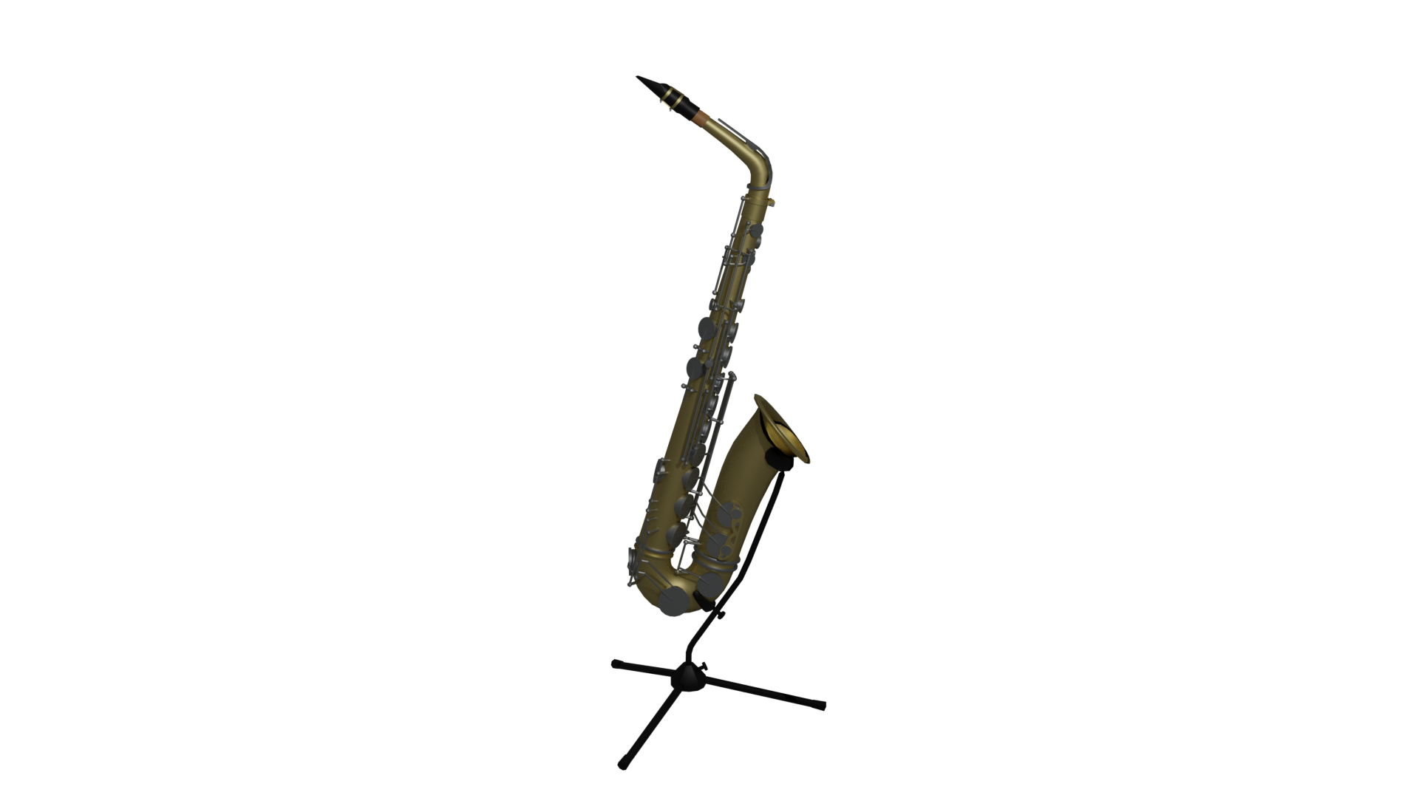
The
History
of the
Saxophone
Pictured: Alto Saxophone. Saxophone by Matt Caddie is licensed under CC-BY.
Notes:
History of the saxophone

Slide 3
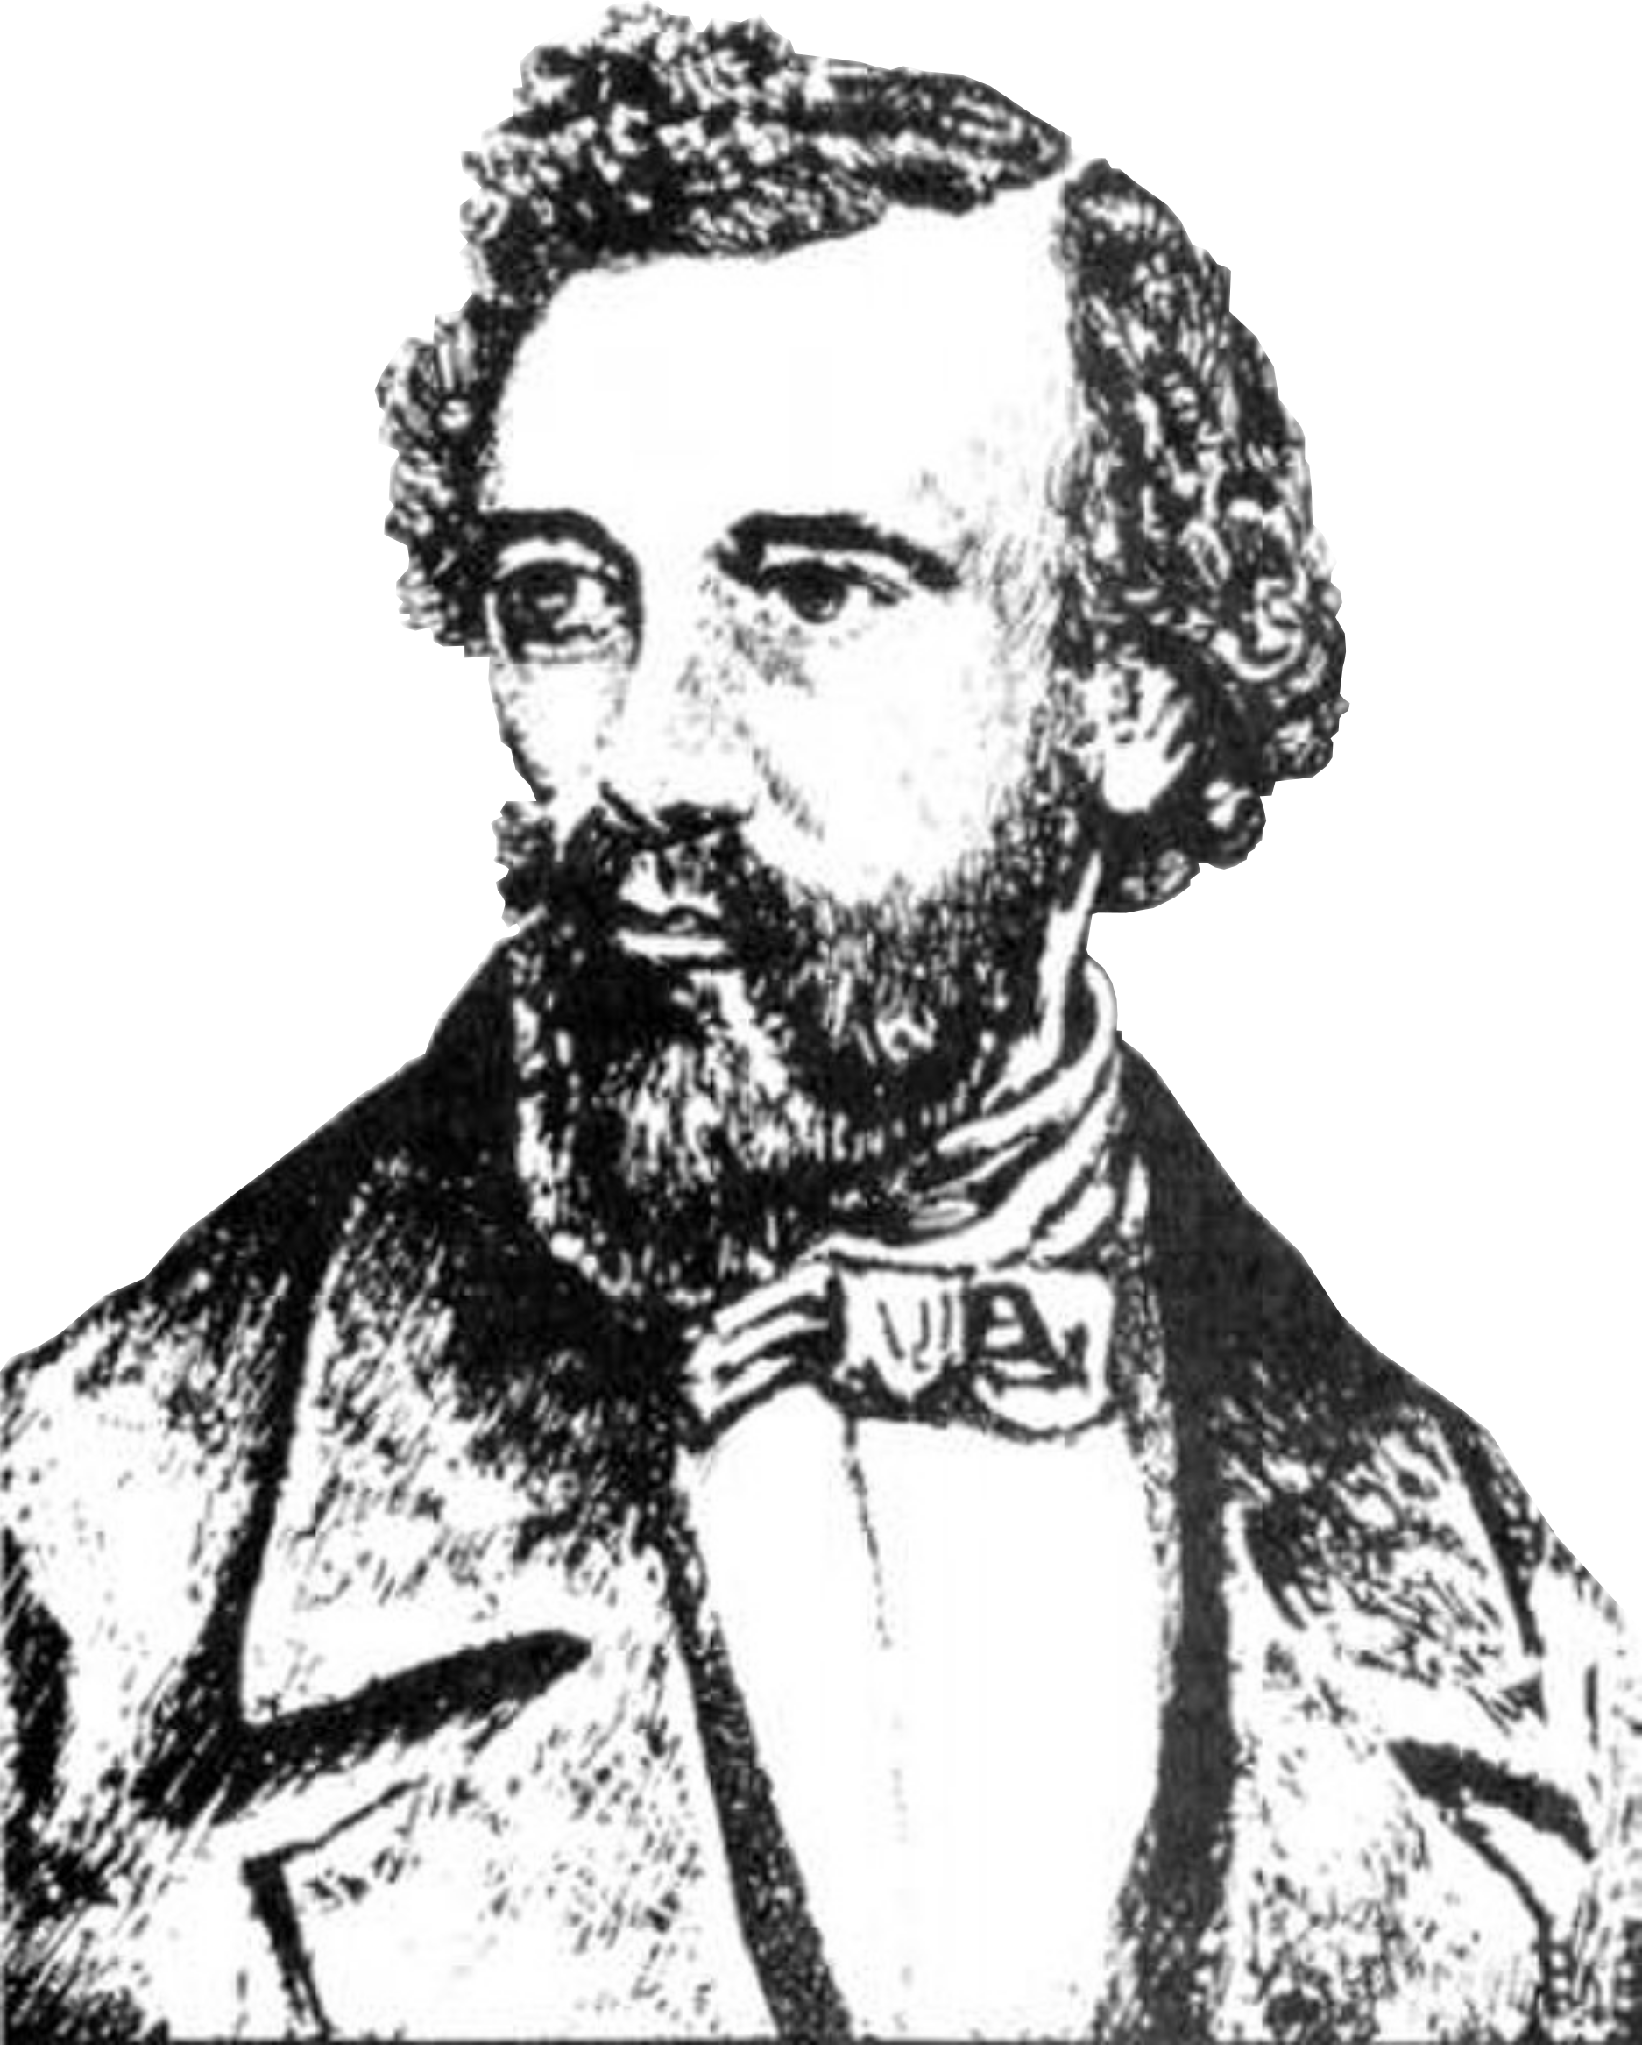
Adolphe Sax
Born - 6 Nov. 1814
[1]
Photo of Adolphe Sax is public domain.
Notes:
- Adolphe Sax
- Born 6 Nov. 1814 | Dinant, Belgium
- Died 4 Feb. 1894 | Paris, France
- Son of Charles-Joseph Sax
- First started working with musical instruments in his father’s workshop.
- Student at the Brussels Conservatory, developed musical skills that helped him design instruments.
- Moved to Paris in 1842 to continue his career after rejecting offers located in London and St. Petersburg.

Slide 4
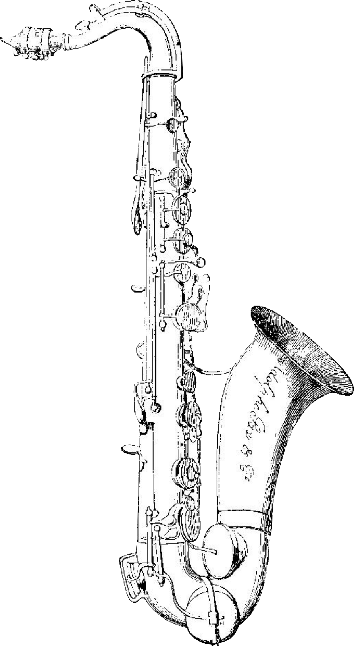
Invented around 1840.
First played in public in
December 1844.
Patented in March 1846.
[2]
Pictured: Engraving of the instrument originally patented by Adolphe Sax. Image unattributed from Grove Music Online. Image used under Fair Dealing.
Notes:
- Image: Engraving of original patent image.
- Invented around 1840.
- First performed publicly 1 Dec. 1844 in the première of Kastner's opera Le dernier roi de Juda.
“Le derni-ey rwa de Zhuda”
- 21 March 1846 - Sax finally applied for a French patent for ‘a new system of wind instruments, called the saxophone’.
- Now they are produced by companies such as:
- Weril (Brazil)
- Yamaha (JP)
- Yanagisawa (JP)

Slide 5
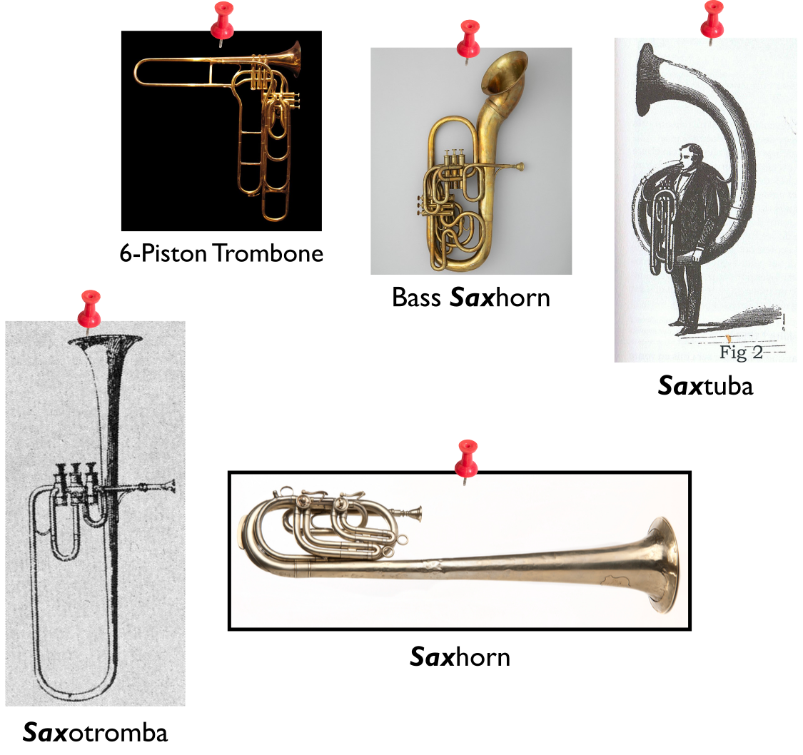
[3]
Saxhorn photo by the Minnesota Historical Society (CC-BY-SA). 6-Piston Trombone photo by Wikipedia user Rama (CC-BY-SA). All other photos are public domain.
Notes:
- Other Instruments
- 6-Piston Trombone
- Saxotromba
- Saxtuba
- Saxhorn & Bass Saxhorn

Slide 6
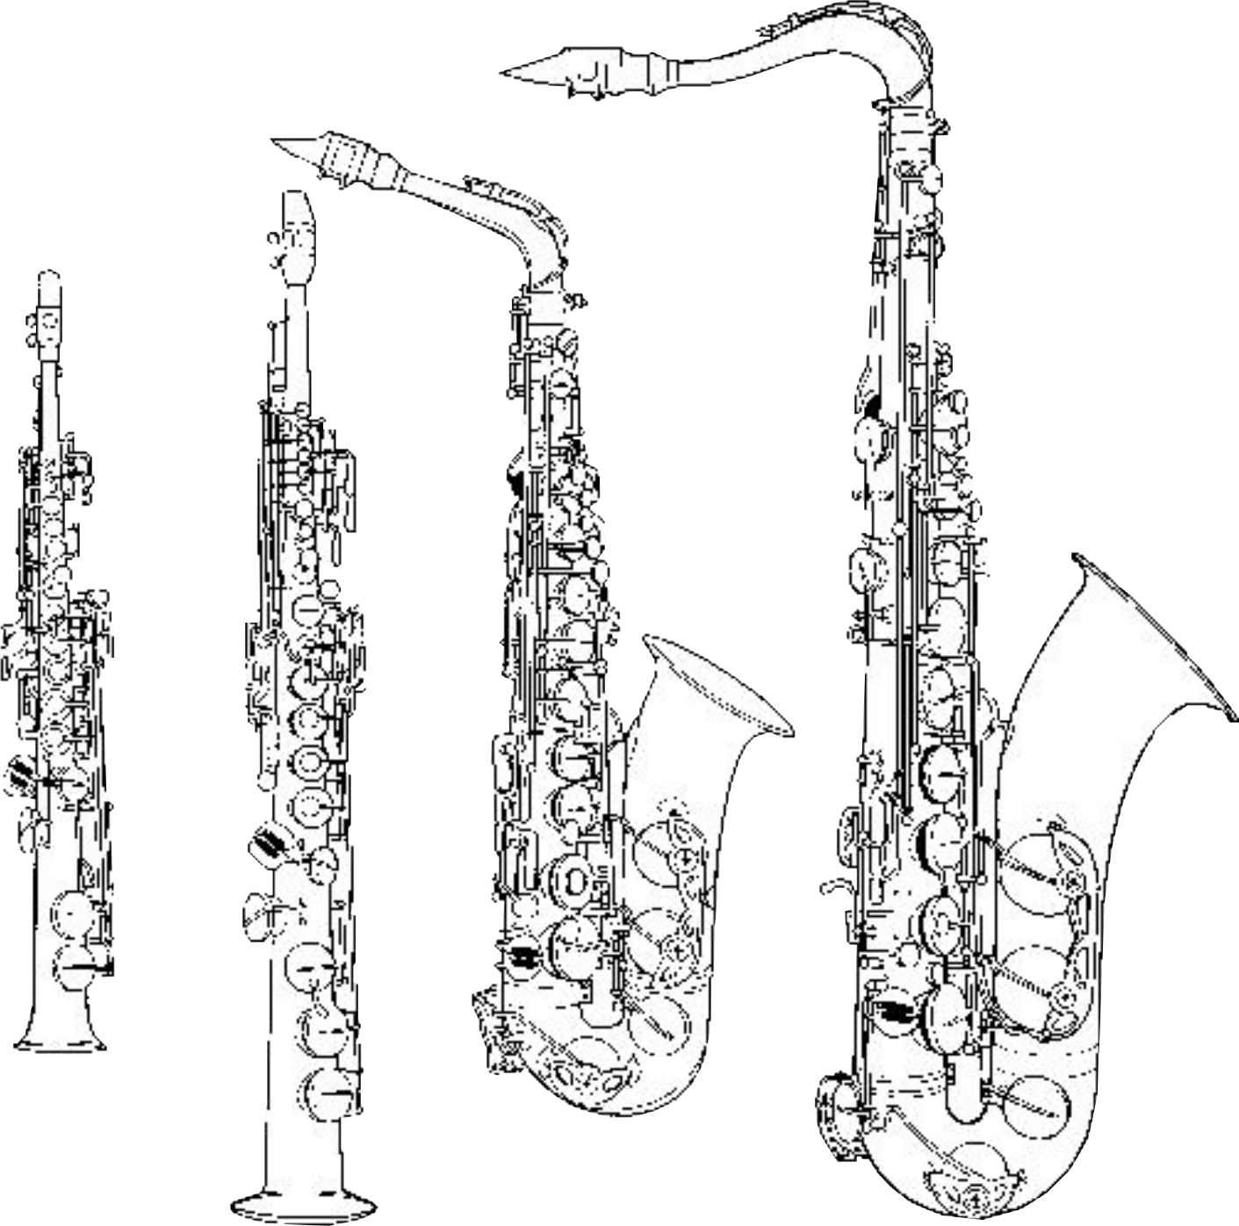
A) Sopranino in E♭
B) Soprano in B♭
C) Alto in E♭
D) Tenor in B♭
[2]
Image unattributed from Grove Music Online.
Notes:
Some Types of Saxophones:
A) Sopranino in Eb
B) Soprano in Bb
C) Alto in Eb
D) Tenor in Bb
All Saxes:
(Bold = Listed)
1 Sopranissimo B♭
2 Sopranino E♭
3 Soprano B♭
4 Alto E♭
5 Tenor B♭
6 Baritone E♭
7 Bass B♭
8 Contrabass E♭
9 Subcontrabass B♭

Slide 7

Mouthpiece
[2]
Saxophone by Matt Caddie is licensed under CC-BY.
Notes:
- Mouthpiece
- Holds a reed (wider than that of a clarinet)
- Usually made from ebonite, wood, metal, plastic or even glass.

Slide 8
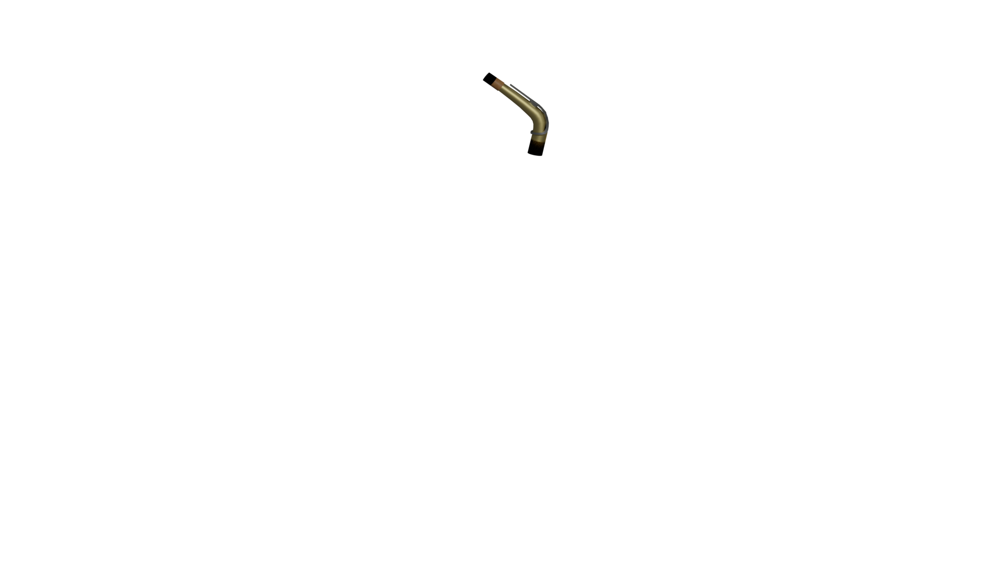
Ligature
Saxophone by Matt Caddie is licensed under CC-BY.
Notes:
- Ligature
- Connects mouthpiece and body

Slide 9
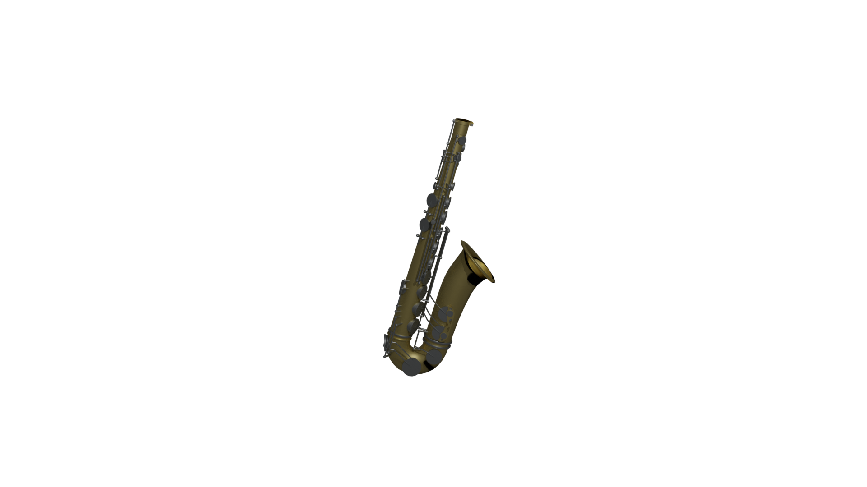
Body
[2]
Saxophone by Matt Caddie is licensed under CC-BY.
Notes:
- Body
- Metals used for the body and the ligature include brass, bronze, copper, steel, silver and sometimes aluminium;
- Wood and glass are also used but are less common.

Slide 10
Adolphe Sax
Died – 4 Feb. 1894
[1], [3], [4]
Photo of Adolphe Sax is public domain.
Notes:
- Adolphe Sax
- Sax suffered from lip cancer between 1853 and 1858 but made a full recovery.
- Died 4 Feb. 1894 | Paris, France from pneumonia in poverty (due to a number of lawsuits against him).

Slide 11
Credits and Citations
[1] – Philip Bate and Wally Horwood. "Sax family." Grove Music Online. 2001; Accessed 20 Sep. 2021. https://www.oxfordmusiconline.com/grovemusic/view/10.1093/gmo/9781561592630.001.0001/omo-9781561592630-e-0000024666.
[2] – Claus Raumberger and Karl Ventzke. "Saxophone." Grove Music Online. 2001; Accessed 20 Sep. 2021. https://www.oxfordmusiconline.com/grovemusic/view/10.1093/gmo/9781561592630.001.0001/omo-9781561592630-e-0000024670.
[3] – Wikipedia contributors. "Adolphe Sax." Wikipedia, The Free Encyclopedia; Accessed 20 Sep. 2021.
https://en.wikipedia.org/w/index.php?title=Adolphe_Sax&oldid=1039798100.
[4] – Adolphe Sax’s Obituary in the New-York Tribune, 10 Feb. 1894; Accessed 20 Sep. 2021.
https://www.newspapers.com/clip/3568998/adolphe-sax-obituary/
All images used under their listed licences as well as Fair Dealing as described by S. 32 of the Copyright, Designs and Patents Act 1988.
Produced by Oliver Kotla
Notes:
Credits and Citations

